Slide 1
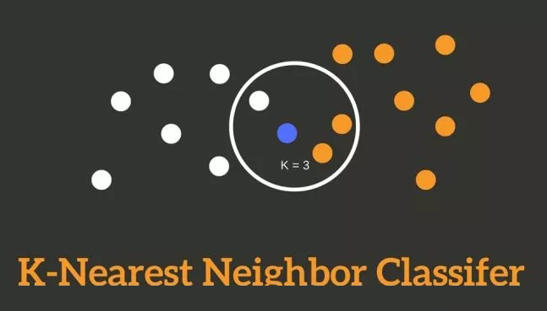
Copyright © www.ITbodhi.com

Slide 2
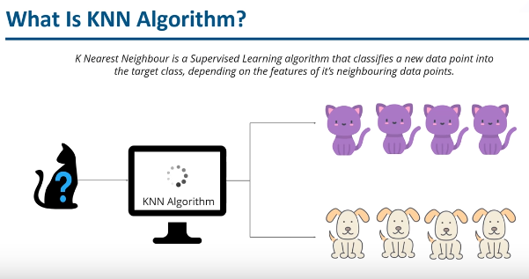
Image from Edureka
Copyright © www.ITbodhi.com

Slide 3
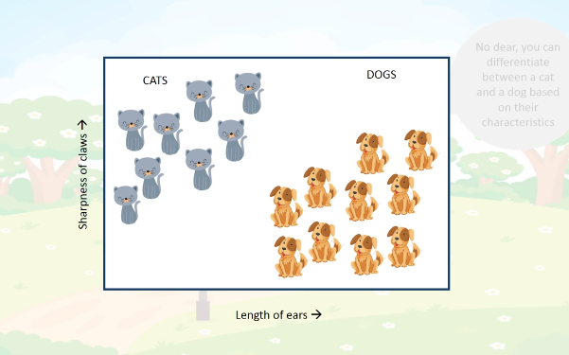
Image from Simpllearn
Copyright © www.ITbodhi.com

Slide 4
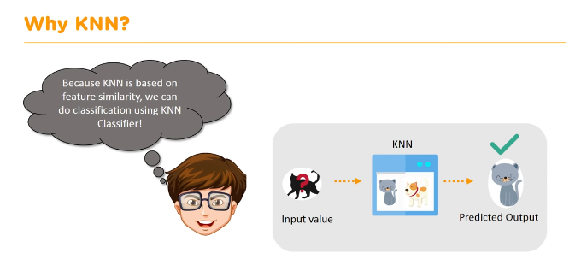
Image from Simpllearn
Copyright © www.ITbodhi.com

Slide 5
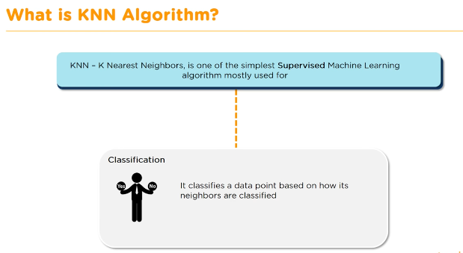
Image from Simpllearn
Copyright © www.ITbodhi.com

Slide 6
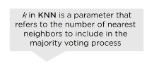
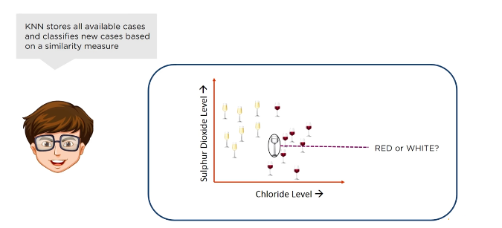
Image from Simpllearn
Copyright © www.ITbodhi.com

Slide 7
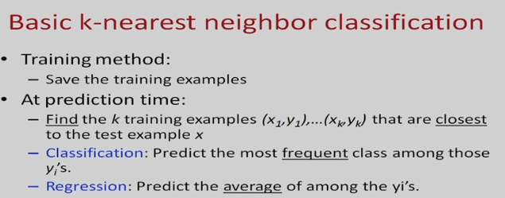
Image from Simpllearn
Copyright © www.ITbodhi.com

Slide 8
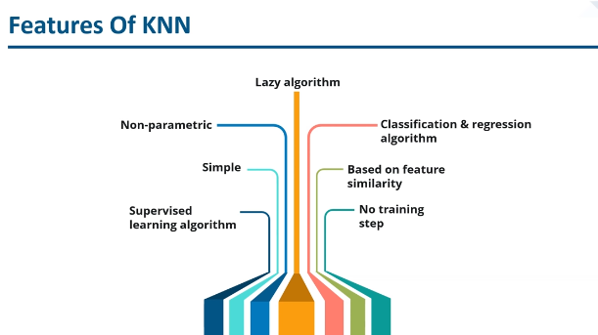
Image from Edureka
Copyright © www.ITbodhi.com
Notes:
Non parametric means it does not make any assumption about the data like other models that data should be linearly seperable,gaussian mixtures etc.

Slide 9

Copyright © www.ITbodhi.com

Slide 10
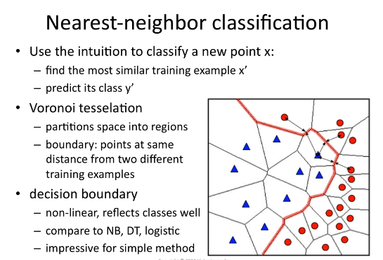
Copyright © www.ITbodhi.com

Slide 11
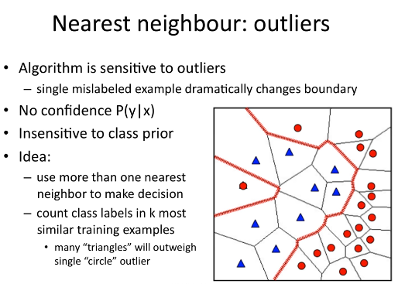
Copyright © www.ITbodhi.com

Slide 12
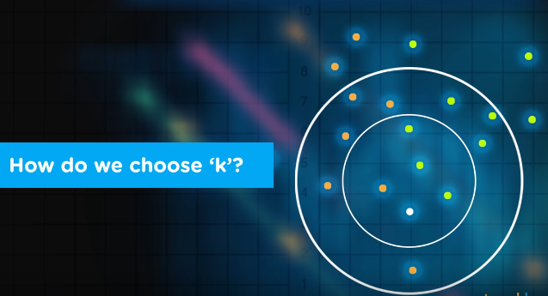
Image from Simpllearn
Copyright © www.ITbodhi.com

Slide 13
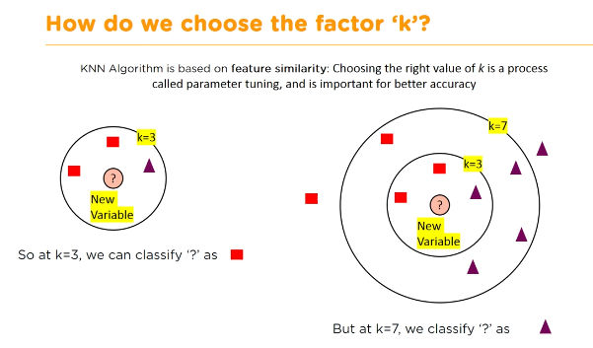
Image from Simpllearn
Copyright © www.ITbodhi.com

Slide 14
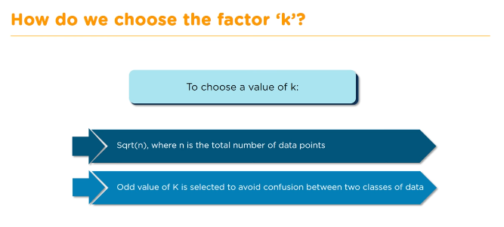
Image from Simpllearn
Copyright © www.ITbodhi.com

Slide 15
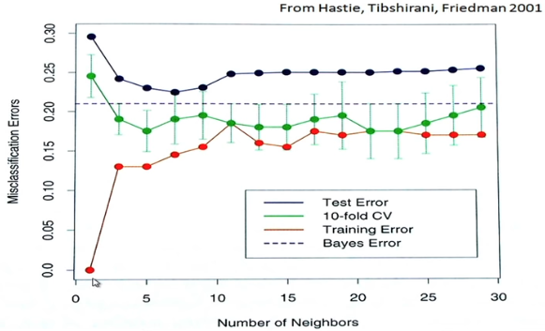
Image from Simpllearn
Copyright © www.ITbodhi.com

Slide 16
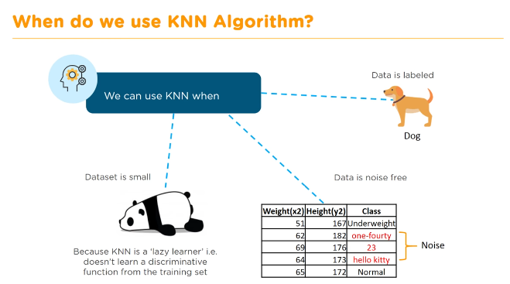
Image from Simpllearn
Copyright © www.ITbodhi.com

Slide 17
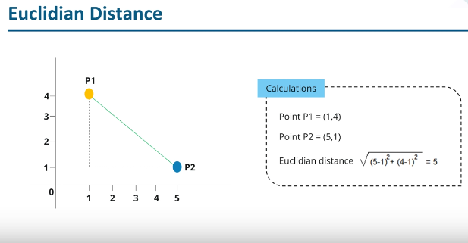
Image from Edureka
Copyright © www.ITbodhi.com

Slide 18
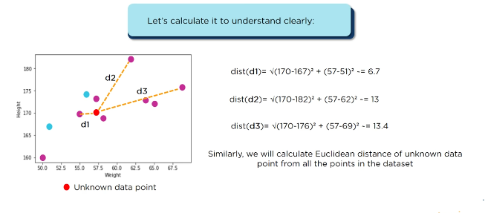
Image from Edureka
Copyright © www.ITbodhi.com

Slide 19
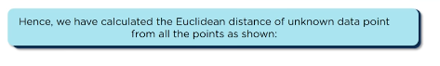
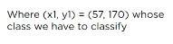
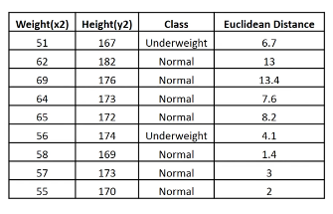
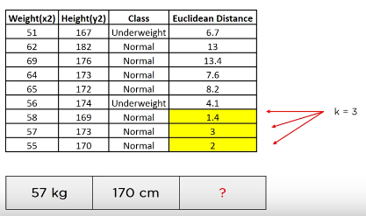
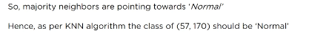
Image from Edureka
Copyright © www.ITbodhi.com

Slide 20
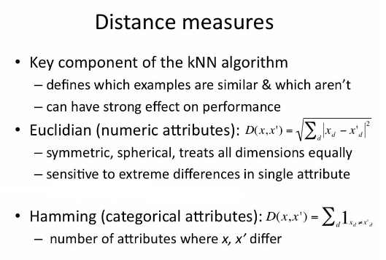
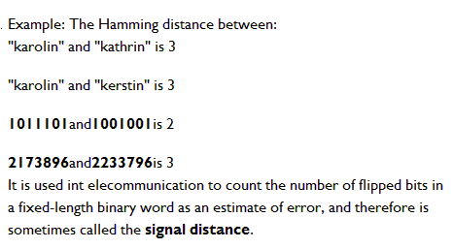
Manhattan distance is often used in integrated circuits where wires only run parallel to the X or Y axis.
It is also known as rectilinear distance, Minkowski’s L1 distance, taxi cab metric, or city block distance.
Copyright © www.ITbodhi.com
Notes:
Assumption with Euclidean distance:
Weight of all the features are considered same.
Scale of all the features are considered same.
Larger K
Use weighted eucledian distance
What to be done:
Scaling all attributes to same range.

Slide 21
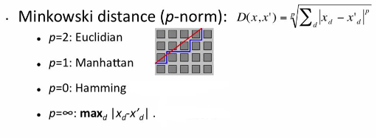
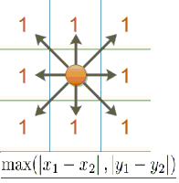
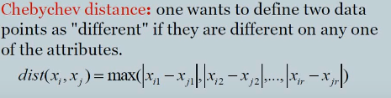
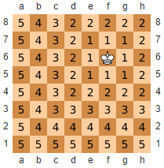
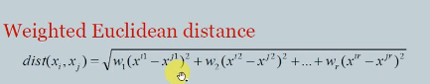
: Chebyshev
Chebyshev distance:
It is also known as chess board distance, since in the game of chess the minimum number of moves needed by a king to go from one square on a chess board to another equals the Chebyshev distance between the centers of the squares
Copyright © www.ITbodhi.com

Slide 22
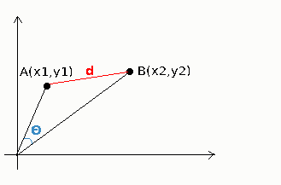
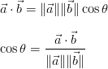
The Cosine Similarity
The cosine similarity between two vectors (or two documents on the Vector Space) is a measure that calculates the cosine of the angle between them.
This metric is a measurement of orientation and not magnitude.
When to Use Cosine?
Cosine similarity is generally used as a metric for measuring distance when the magnitude of the vectors does not matter. This happens for example when working with text data represented by word counts. We could assume that when a word (e.g. science) occurs more frequent in document 1 than it does in document 2, that document 1 is more related to the topic of science. However, it could also be the case that we are working with documents of uneven lengths (Wikipedia articles for example). Then, science probably occurred more in document 1 just because it was way longer than document 2. Cosine similarity corrects for this.
Copyright © www.ITbodhi.com

Slide 23
Best data practice for KNN
Rescale Data: KNN performs much better if all of the data has the same scale. Normalizing your data to the range [0, 1] is a good idea. It may also be a good idea to standardize your data if it has a Gaussian distribution.
Address Missing Data: Missing data will mean that the distance between samples can not be calculated. These samples could be excluded or the missing values could be imputed.
Lower Dimensionality: KNN is suited for lower dimensional data. You can try it on high dimensional data (hundreds or thousands of input variables) but be aware that it may not perform as well as other techniques. KNN can benefit from feature selection that reduces the dimensionality of the input feature space.
Copyright © www.ITbodhi.com

Slide 24
Pros of K Nearest Neighbors
Simple algorithm and hence easy to interpret the prediction
Non parametric, so makes no assumption about the underlying data pattern
used for both classification and Regression
Training step is much faster for nearest neighbor compared to other machine learning algorithms
Cons of K Nearest Neighbors
KNN is computationally expensive as it searches the nearest neighbors for the new point at the prediction stage
High memory requirement as KNN has to store all the data points
Prediction stage is very costly
Sensitive to outliers, accuracy is impacted by noise or irrelevant data.
Copyright © www.ITbodhi.com

Slide 25
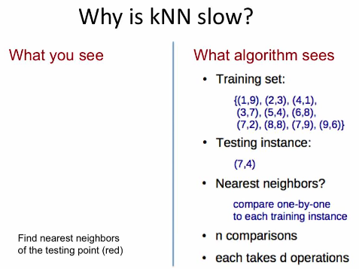
Copyright © www.ITbodhi.com

Slide 26
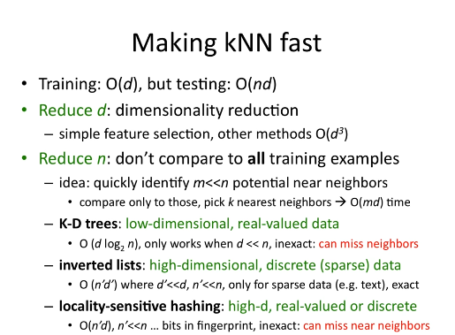
Copyright © www.ITbodhi.com

Slide 27
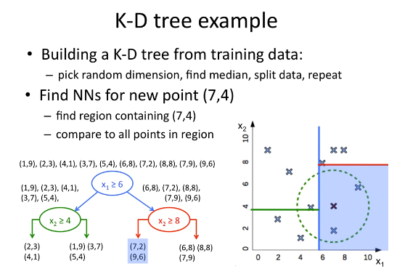
Copyright © www.ITbodhi.com

Slide 28
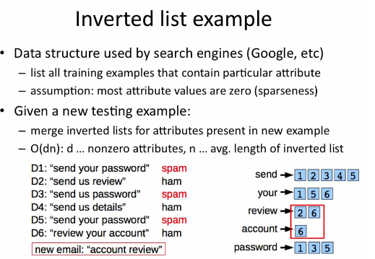
Copyright © www.ITbodhi.com

Slide 29
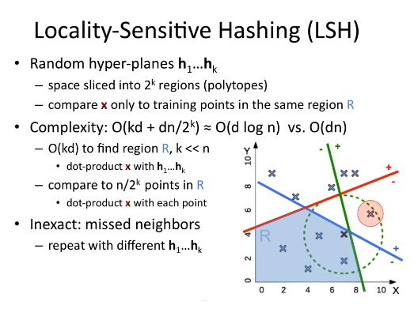
Copyright © www.ITbodhi.com

Slide 30
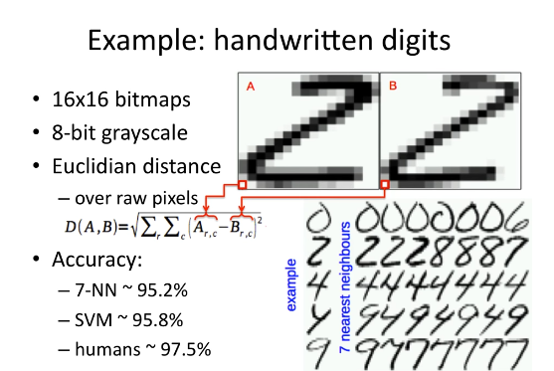
Copyright © www.ITbodhi.com

Slide 31
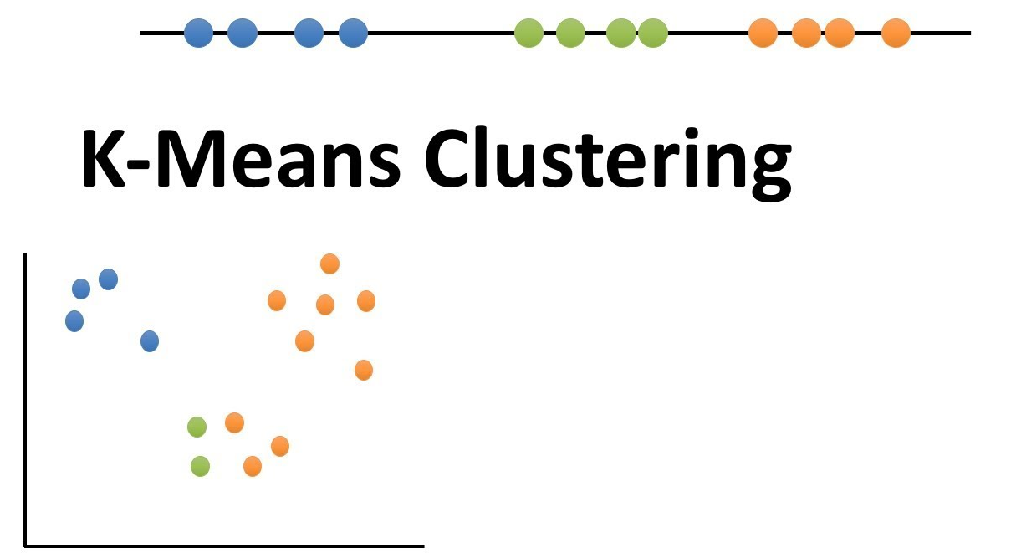
Copyright © www.ITbodhi.com

Slide 32
Clustering is a method of unsupervised learning
where the data we want to describe is not labeled.
Where user does not give us much information of what is the expected output.
The purpose of clustering and classification algorithms is to make sense of and extract value from large sets of structured and unstructured data.
If you’re working with huge volumes of unstructured data, it only makes sense to try to partition the data into some sort of logical groupings before attempting to analyze it.
Grouping of data points.
Given a set of data points, clustering algorithm classify each data point into a specific group.
Data points that are in the same group should have similar properties and/or features.
Data points in different groups should have highly dissimilar properties and/or features.
Copyright © www.ITbodhi.com

Slide 33
Possible Applications:
Clustering algorithms can be applied in many fields, for instance:
Marketing: finding groups of customers with similar behavior given a large database of customer data containing their properties and past buying records;
Biology: classification of plants and animals given their features;
Libraries: book ordering;
Insurance: identifying groups of motor insurance policy holders with a high average claim cost; identifying frauds;
City-planning: identifying groups of houses according to their house type, value and geographical location;
Earthquake studies: clustering observed earthquake epicenters to identify dangerous zones;
WWW: document classification; clustering weblog data to discover groups of similar access patterns.
The main requirements that a clustering algorithm should satisfy are:
scalability;
dealing with different types of attributes;
discovering clusters with arbitrary shape;
minimal requirements for domain knowledge to determine input parameters;
ability to deal with noise and outliers;
insensitivity to order of input records;
high dimensionality;
interpretability and usability.
Copyright © www.ITbodhi.com

Slide 34
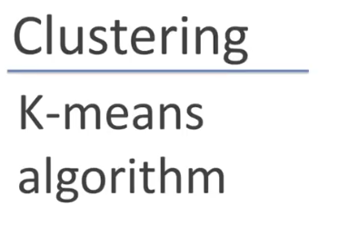
Image from AndrewNG
Copyright © www.ITbodhi.com

Slide 35
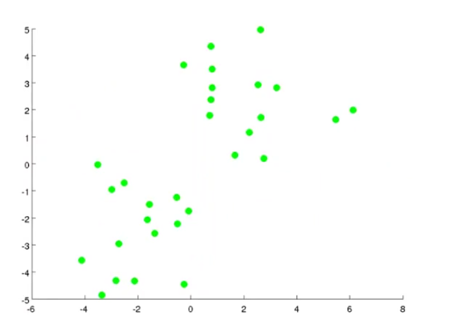
Given all the unlabeled data points
Image from AndrewNG
Copyright © www.ITbodhi.com

Slide 36
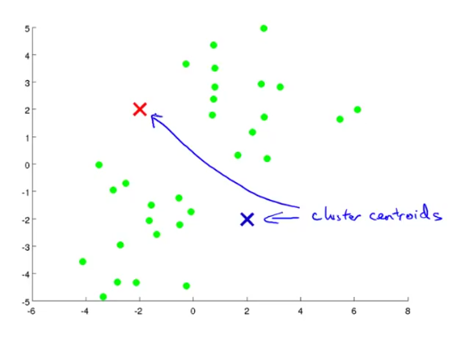
First select a number of classes/groups for clustering.
Randomly initialize their respective center points called cluster centroids.
Image from AndrewNG
Copyright © www.ITbodhi.com

Slide 37
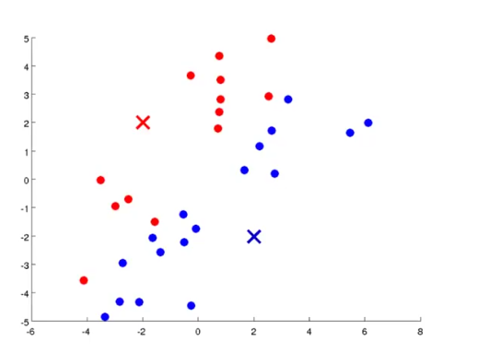
Each data point is classified by computing the distance between that point and each centroid and then classifying the point to be in the group whose center is closest to it.
Image from AndrewNG
Copyright © www.ITbodhi.com

Slide 38
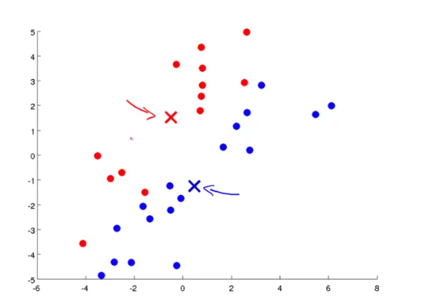
Based on these classified points, re-compute the group center by taking the mean of all the data point vectors in the group and shift the centroids.
Image from AndrewNG
Copyright © www.ITbodhi.com

Slide 39
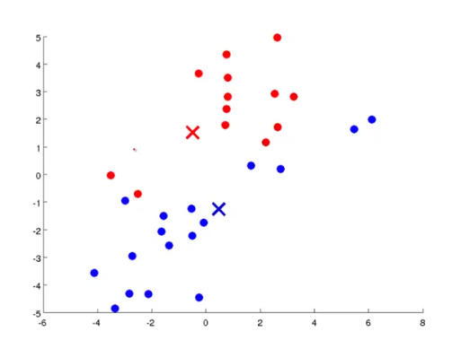
Now again calculate the distance of each data point vectors from the new position of centroids and assign them to any of the centroids on the basis of the minimum distance.
Image from AndrewNG
Copyright © www.ITbodhi.com

Slide 40
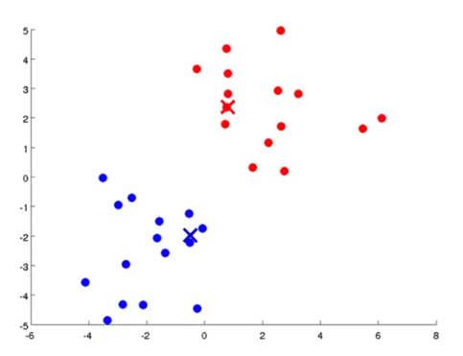
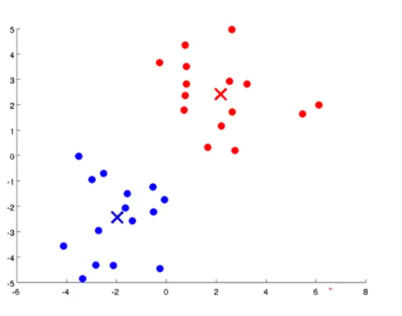
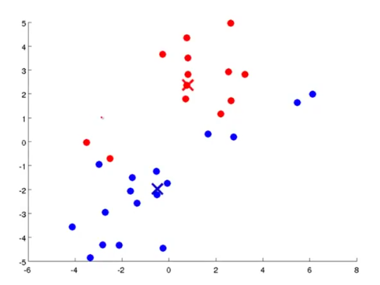
Repeat these steps for a set number of iterations or until the group centers don’t change much between iterations.
Image from AndrewNG
Copyright © www.ITbodhi.com

Slide 41
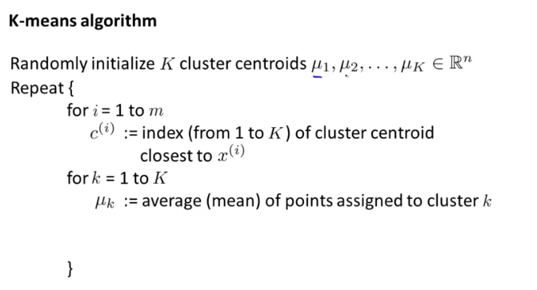
Image from AndrewNG
Copyright © www.ITbodhi.com

Slide 42
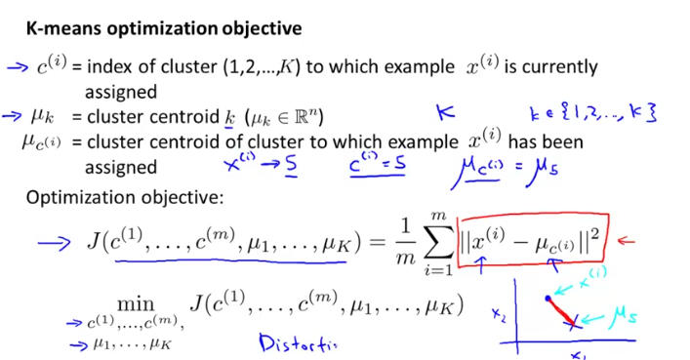
Image from AndrewNG
Copyright © www.ITbodhi.com

Slide 43

Image from AndrewNG
Copyright © www.ITbodhi.com

Slide 44

Image from AndrewNG
Copyright © www.ITbodhi.com

Slide 45

Clustering gets affected by the random initialization of the centroids.
Image from AndrewNG
Copyright © www.ITbodhi.com

Slide 46

If 2=<K <= 10 random initialization has greater impact on clustering but if k>=10 random initialization has very less impact on clustering and most probably very first random initialization of centroids will give pretty good result..
Image from AndrewNG
Copyright © www.ITbodhi.com

Slide 47

Image from AndrewNG
Copyright © www.ITbodhi.com

Slide 48


Image from AndrewNG
Copyright © www.ITbodhi.com

Slide 49

Image from AndrewNG
Copyright © www.ITbodhi.com

Slide 50

Image from AndrewNG
Copyright © www.ITbodhi.com

Slide 51
Advantages:
it’s pretty fast,
Computing the distances between points and group centers. Very few computations. It thus has a linear complexity O(n)
Disadvantages:
Firstly, you have to select how many groups/classes there are. This isn’t always trivial
K-means also starts with a random choice of cluster centers and therefore it may yield different clustering results on different runs of the algorithm. Thus, the results may not be repeatable and lack consistency.
K-Medians is another clustering algorithm related to K-Means, except instead of re computing the group center points using the mean we use the median vector of the group. This method is less sensitive to outliers (because of using the Median) but is much slower for larger datasets as sorting is required on each iteration when computing the Median vector.
Image from AndrewNG
Copyright © www.ITbodhi.com

Slide 52
Top 5 Clustering Algorithms
K-Means Clustering
Mean-Shift Clustering
Density-Based Spatial Clustering of Applications with Noise (DBSCAN)
Expectation–Maximization (EM) Clustering using Gaussian Mixture Models (GMM)
Agglomerative Hierarchical Clustering
https://towardsdatascience.com/the-5-clustering-algorithms-data-scientists-need-to-know-a36d136ef68
Image from AndrewNG
Copyright © www.ITbodhi.com

Slide 53
Mean-Shift Clustering
Mean shift clustering is a sliding-window-based algorithm that attempts to find dense areas of data points.
It is a centroid-based algorithm meaning that the goal is to locate the center points of each group/class, which works by updating candidates for center points to be the mean of the points within the sliding-window.
These candidate windows are then filtered in a post-processing stage to eliminate near-duplicates, forming the final set of center points and their corresponding groups.
Image from AndrewNG
Copyright © www.ITbodhi.com

Slide 54
Steps:
Consider a set of points in two-dimensional We begin with a circular sliding window centered at a point C (randomly selected) and having radius r as the kernel. Mean shift is a hill climbing algorithm which involves shifting this kernel iteratively to a higher density region on each step until convergence.
At every iteration the sliding window is shifted towards regions of higher density by shifting the center point to the mean of the points within the window (hence the name). The density within the sliding window is proportional to the number of points inside it. Naturally, by shifting to the mean of the points in the window it will gradually move towards areas of higher point density.
We continue shifting the sliding window according to the mean until there is no direction at which a shift can accommodate more points inside the kernel. we keep moving the circle until we no longer are increasing the density (i.e number of points in the window).
This process of steps 1 to 3 is done with many sliding windows until all points lie within a window. When multiple sliding windows overlap the window containing the most points is preserved. The data points are then clustered according to the sliding window in which they reside.
Image from AndrewNG
Copyright © www.ITbodhi.com

Slide 55
Steps:
Mean-Shift Clustering for a single sliding window
https://miro.medium.com/max/324/1*bkFlVrrm4HACGfUzeBnErw.gif
The entire process of Mean-Shift Clustering
https://miro.medium.com/max/432/1*vyz94J_76dsVToaa4VG1Zg.gif
Image from AndrewNG
Copyright © www.ITbodhi.com

Slide 56
Advantages:
Contrast to K-means clustering there is no need to select the number of clusters as mean-shift automatically discovers this.
Cluster centers converge towards the points of maximum density is also quite desirable as it is quite intuitive to understand and fits well in a naturally data-driven sense.
Disadvantage:
The drawback is that the selection of the window size/radius “r” can be non-trivial.
Image from AndrewNG
Copyright © www.ITbodhi.com

Slide 57
Density-Based Spatial Clustering of Applications with Noise (DBSCAN)
DBSCAN is a density based clustered algorithm similar to mean-shift, but with a couple of notable advantages.
Steps:
DBSCAN begins with an arbitrary starting data point that has not been visited. The neighborhood of this point is extracted using a distance epsilon ε (All points which are within the ε distance are neighborhood points).
If there are a sufficient number of points (according to minPoints) within this neighborhood then the clustering process starts and the current data point becomes the first point in the new cluster. Otherwise, the point will be labeled as noise (later this noisy point might become the part of the cluster). In both cases that point is marked as “visited”.
Image from AndrewNG
Copyright © www.ITbodhi.com

Slide 58
Steps:
3. For this first point in the new cluster, the points within its ε distance neighborhood also become part of the same cluster. This procedure of making all points in the ε neighborhood belong to the same cluster is then repeated for all of the new points that have been just added to the cluster group.
4. This process of steps 2 and 3 is repeated until all points in the cluster are determined i.e all points within the ε neighborhood of the cluster have been visited and labeled.
5. Once we’re done with the current cluster, a new unvisited point is retrieved and processed, leading to the discovery of a further cluster or noise. This process repeats until all points are marked as visited. Since at the end of this all points have been visited, each point well have been marked as either belonging to a cluster or being noise.
Image from AndrewNG
Copyright © www.ITbodhi.com

Slide 59
https://miro.medium.com/max/675/1*tc8UF-h0nQqUfLC8-0uInQ.gif
Image from AndrewNG
Copyright © www.ITbodhi.com

Slide 60
Advantages:
DBSCAN poses some great advantages over other clustering algorithms.
Firstly, it does not require a pe-set number of clusters at all.
It also identifies outliers as noises unlike mean-shift which simply throws them into a cluster even if the data point is very different.
Additionally, it is able to find arbitrarily sized and arbitrarily shaped clusters quite well.
Disadvantages:
The main drawback of DBSCAN is that it doesn’t perform as well as others when the clusters are of varying density. This is because the setting of the distance threshold ε and minPoints for identifying the neighborhood points will vary from cluster to cluster when the density varies.
This drawback also occurs with very high-dimensional data since again the distance threshold ε becomes challenging to estimate.
Image from AndrewNG
Copyright © www.ITbodhi.com

Slide 61

Expectation–Maximization (EM) Clustering using Gaussian Mixture Models (GMM)
One of the major drawbacks of K-Means is its naive use of the mean value for the cluster center. We can see why this isn’t the best way of doing things by looking at the image below.
In the image it looks quite obvious to the human eye that there are two circular clusters with different radius’ centered at the same mean. K-Means can’t handle this because the mean values of the clusters are a very close together.
K-Means also fails in cases where the clusters are not circular, again as a result of using the mean as cluster center.
Image from AndrewNG
Copyright © www.ITbodhi.com

Slide 62
Expectation–Maximization (EM) Clustering using Gaussian Mixture Models (GMM)
Gaussian Mixture Models (GMMs) give us more flexibility than K-Means. With GMMs we assume that the data points are Gaussian distributed; this is a less restrictive assumption than saying they are circular by using the mean. That way, we have two parameters to describe the shape of the clusters: the mean and the standard deviation! Taking an example in two dimensions, this means that the clusters can take any kind of elliptical shape (since we have standard deviation in both the x and y directions). Thus, each Gaussian distribution is assigned to a single cluster.
In order to find the parameters of the Gaussian for each cluster (e.g the mean and standard deviation) we will use an optimization algorithm called Expectation–Maximization (EM).
Image from AndrewNG
Copyright © www.ITbodhi.com

Slide 63
Steps:
1. We begin by selecting the number of clusters (like K-Means does) and randomly initializing the Gaussian distribution parameters for each cluster. One can try to provide a good guesstimate for the initial parameters by taking a quick look at the data too. Though note, as can be seen in the graphic above, this isn’t 100% necessary as the Gaussians start our as very poor but are quickly
optimized.
2. Given these Gaussian distributions for each cluster, compute the probability that each data point belongs to a particular cluster. The closer a point is to the Gaussian’s center, the more likely it belongs to that cluster. This should make intuitive sense since with a Gaussian distribution we are assuming that most of the data lies closer to the center of the cluster.
Image from AndrewNG
Copyright © www.ITbodhi.com

Slide 64
Steps: https://miro.medium.com/max/360/1*OyXgise21a23D5JCss8Tlg.gif
4. Based on these probabilities, we compute a new set of parameters for the Gaussian distributions such that we maximize the probabilities of data points within the clusters. We compute these new parameters using a weighted sum of the data point positions, where the weights are the probabilities of the data point belonging in that particular cluster. To explain this in a visual manner we can take a look at the graphic above, in particular the yellow cluster as an example. The distribution starts off randomly on the first iteration, but we can see that most of the yellow points are to the right of that distribution. When we compute a sum weighted by the probabilities, even though there are some points near the center, most of them are on the right. Thus naturally the distribution’s mean is shifted closer to those set of points.
5. Steps 2 and 3 are repeated iteratively until convergence, where the distributions don’t change much from iteration to iteration.
Image from AndrewNG
Copyright © www.ITbodhi.com

Slide 65
Advantages:
Firstly GMMs are a lot more flexible in terms of cluster covariance than K-Means; due to the standard deviation parameter, the clusters can take on any ellipse shape, rather than being restricted to circles.
K-Means is actually a special case of GMM in which each cluster’s covariance along all dimensions approaches 0. Secondly, since GMMs use probabilities, they can have multiple clusters per data point. So if a data point is in the middle of two overlapping clusters, we can simply define its class by saying it belongs X-percent to class 1 and Y-percent to class 2. I.e GMMs support mixed membership.
.
Image from AndrewNG
Copyright © www.ITbodhi.com

Slide 66
Agglomerative Hierarchical Clustering
Algorithms treat each data point as a single cluster and then successively merge (or agglomerate) pairs of clusters until all clusters have been merged into a single cluster that contains all data points.
Bottom-up hierarchical clustering is therefore called hierarchical agglomerative clustering or HAC. This hierarchy of clusters is represented as a tree.
The root of the tree is the unique cluster that gathers all the samples, the leaves being the clusters with only one sample.
Image from AndrewNG
Copyright © www.ITbodhi.com

Slide 67
Steps: https://miro.medium.com/max/700/1*ET8kCcPpr893vNZFs8j4xg.gif
We begin by treating each data point as a single cluster i.e if there are X data points in our dataset then we have X clusters. We then select a distance metric that measures the distance between two clusters. As an example we will use average linkage which defines the distance between two clusters to be the average distance between data points in the first cluster and data points in the second cluster.
On each iteration we combine two clusters into one. The two clusters to be combined are selected as those with the smallest average linkage. I.e according to our selected distance metric, these two clusters have the smallest distance between each other and therefore are the most similar and should be combined.
Step 2 is repeated until we reach the root of the tree i.e we only have one cluster which contains all data points. In this way we can select how many clusters we want in the end, simply by choosing when to stop combining the clusters i.e when we stop building the tree!
Copyright © www.ITbodhi.com

Slide 68
Advantages:
Hierarchical clustering does not require us to specify the number of clusters and we can even select which number of clusters looks best since we are building a tree.
Additionally, the algorithm is not sensitive to the choice of distance metric; all of them tend to work equally well whereas with other clustering algorithms, the choice of distance metric is critical.
A particularly good use case of hierarchical clustering methods is when the underlying data has a hierarchical structure and you want to recover the hierarchy; other clustering algorithms can’t do this.
Disadvantages:
These advantages of hierarchical clustering come at the cost of lower efficiency, as it has a time complexity of O(n³), unlike the linear complexity of K-Means and GMM.
Copyright © www.ITbodhi.com

Slide 69

Copyright © www.ITbodhi.com

Slide 70

Image from AndrewNG
Copyright © www.ITbodhi.com

Slide 71

Image from AndrewNG
Copyright © www.ITbodhi.com

Slide 72

Image from AndrewNG
Copyright © www.ITbodhi.com

